Slide 1

Data
Exploration
And
Visiulization

Slide 2
Data visualization and its importance
It is almost impossible for anyone to extract any information from terabytes or petabytes of data without using visualization techniques.
Pictures and visuals way better than any numbers or text
Data visualization techniques are also helpful for the feature engineering part in machine learning

Slide 3
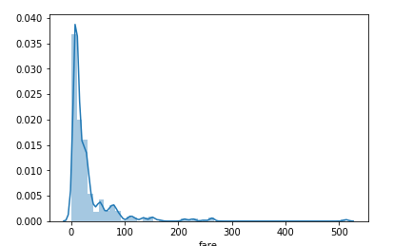
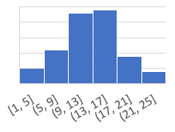
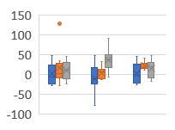
Basic visualization techniques
Matplotlib / Seaborn
Bar chart
Histogram
Density plot or Distribution
Pair Plot
Box Plot
Scatter Plot
Correlation and HeatMap

Slide 4
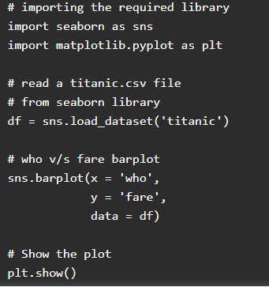
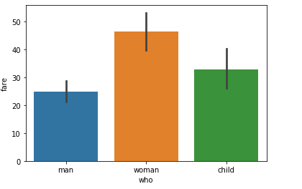
Bar Chart
The bar chart is a frequency chart for a qualitative variable.
A bar chart can be used to access the most-occurring and least-occurring categories within a dataset

Slide 5
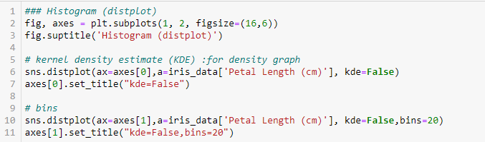
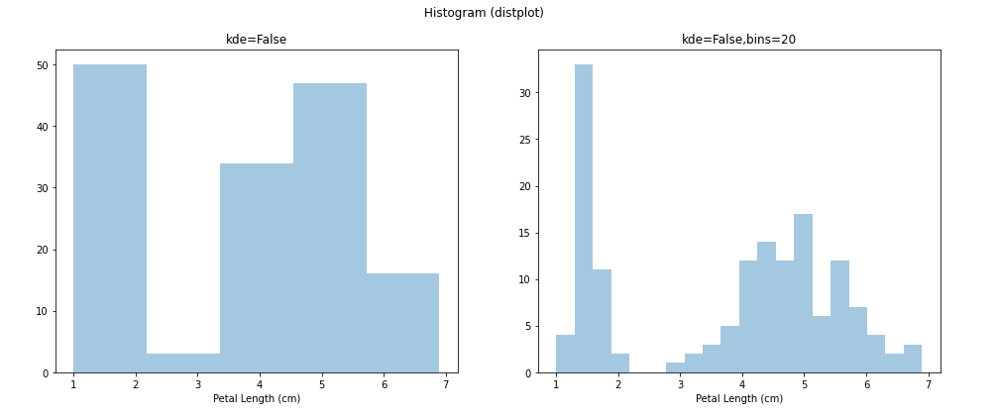
Histogram
A histogram is a plot that shows the frequency distribution of a set of continuous variables.

Slide 6
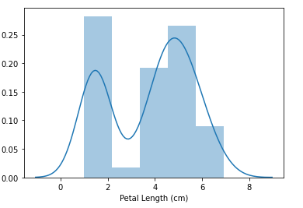

Distribution or Density plot
A distribution or density plot depicts the distribution of data over a continuous interval. A density plot is like a smoothed histogram and visualizes the distribution of data over a continuous interval.

Slide 7


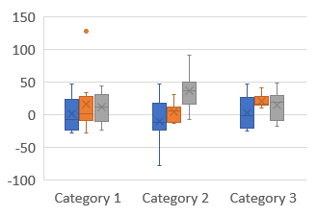
Box Plot
Box plot is a graphical representation of numerical data that can be used to understand the variability of the data and the existence of outliers. Box plot is designed by identifying the following descriptive statistics.
1. Lower quartile, median and upper quartile
2. Lowest and highest values
3. Interquartile range(IQR)
Box plot is constructed using IQR, minimum and maximum values. IQR is the distance between the 3rd quartile and 1st quartile. The length of the box is equivalent to IQR.
Using “Seaborn”
Using “Matplotlib”

Slide 8
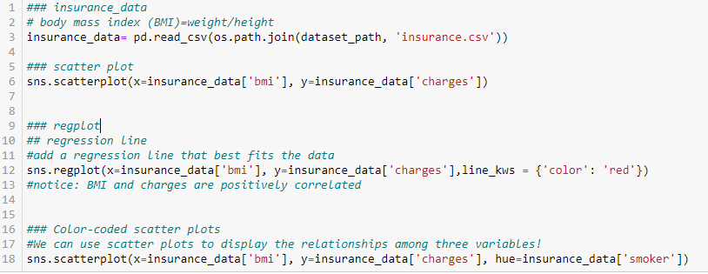
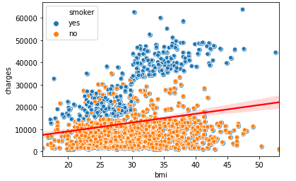
Scatter Plot
In Scatter Plot ,the values of two variables are plotted along two axes and the resulting pattern can reveal correlation present between the variables if any
A scatter plot is also useful for assessing the strength of the relationship and to find if there are any outliers in the data

Slide 9
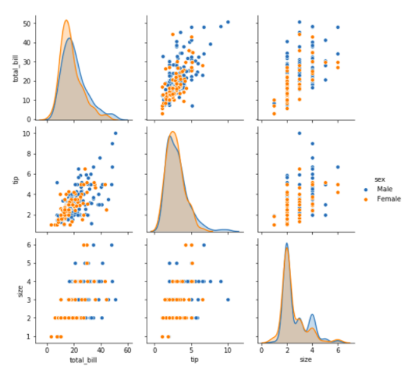
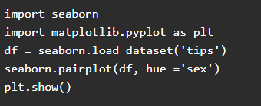
Pair Plot
When we have many variables it is not convenient to draw scatter plots for each pair of variables to understand the relationship
So that we have to use a pair plot to depict the relationship in a single diagram

Slide 10
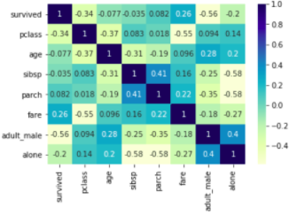
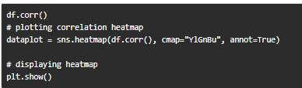
Correlation and HeatMap
Correlation is used for measuring the strength and direction of the linear relationship between two continuous random variables x and y.
A positive correlation means the variables increase or decrease together.
A negative correlation means if one variable increases then the other decrease.

Slide 11
Conclusion
The objective of descriptive analytics is simple comprehension of data using summarization basic statistical measures and visualization.
Matplotlib and seaborn are the two most widely used libraries for creating a visualization.
Plots like histograms, distribution plots, box plots, scatter plots, pair plots, heatmap, can be created to find insights during exploratory analysis.

